Slide 1


VSCode Set up
Here is where your presentation begins

Slide 2
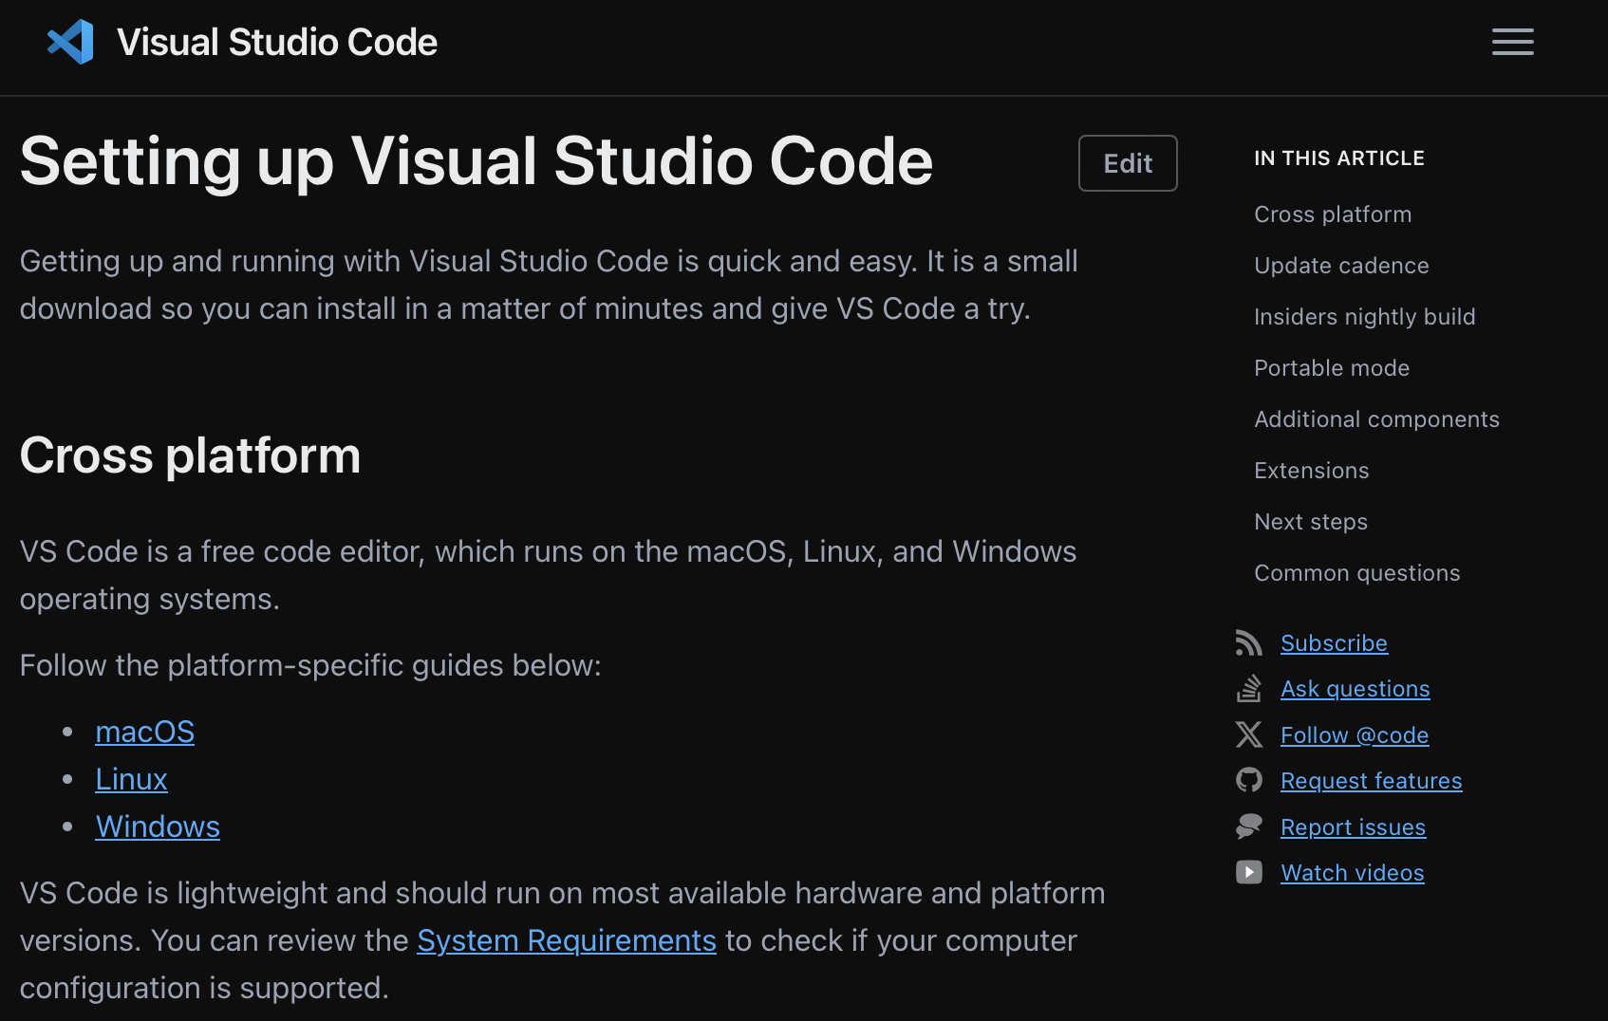
Downloading VScode from the web

Slide 3
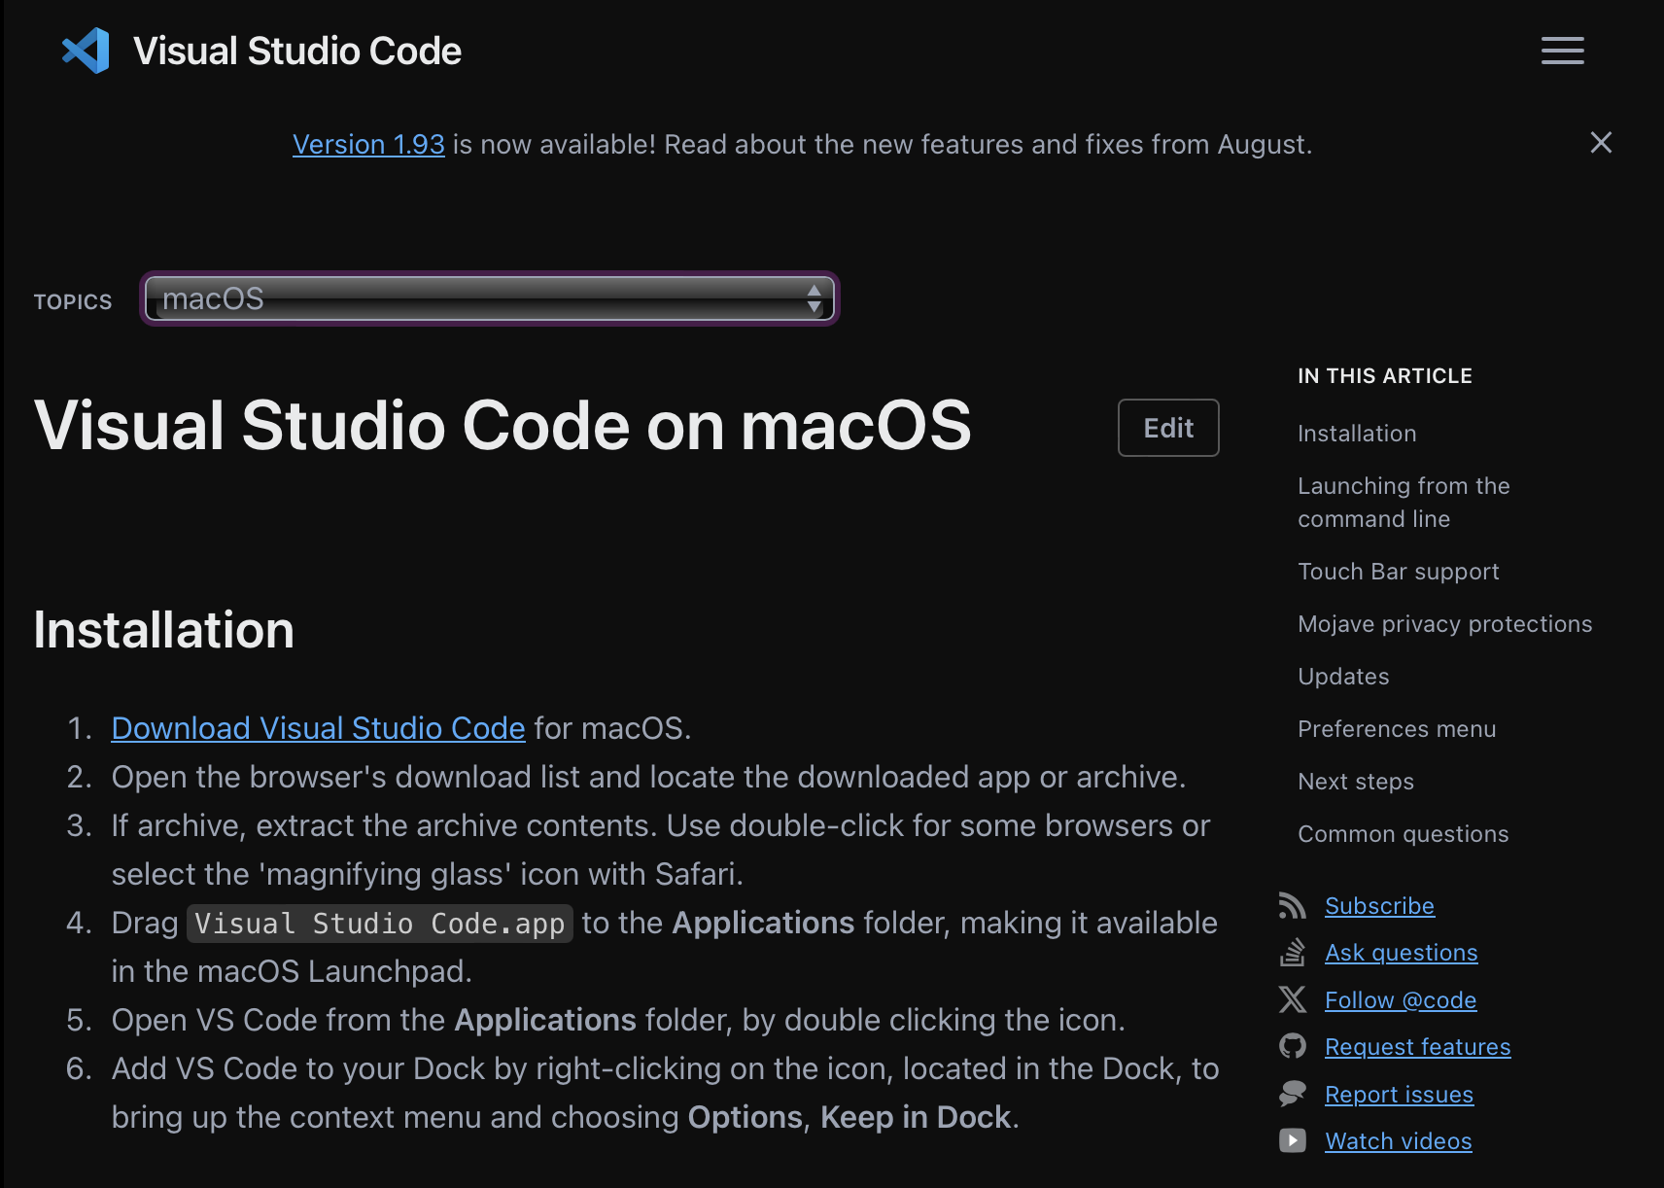

Slide 4

Activity bar
Explorer
search
Source control
Run and debug
Extensions
testing
Github Pull requests
Database projects
connections

Slide 5
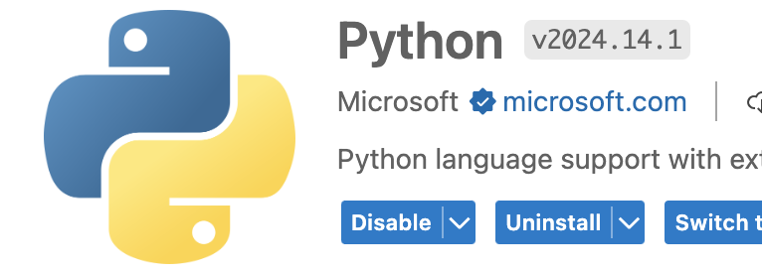
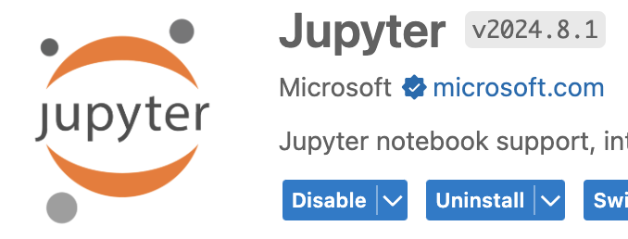
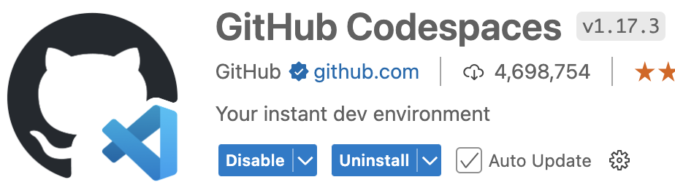
Extensions to download
Go the the extensions tab on the activity bar & install the following 3 extensions (for now)
Make sure the extensions are by Microsoft

Slide 6
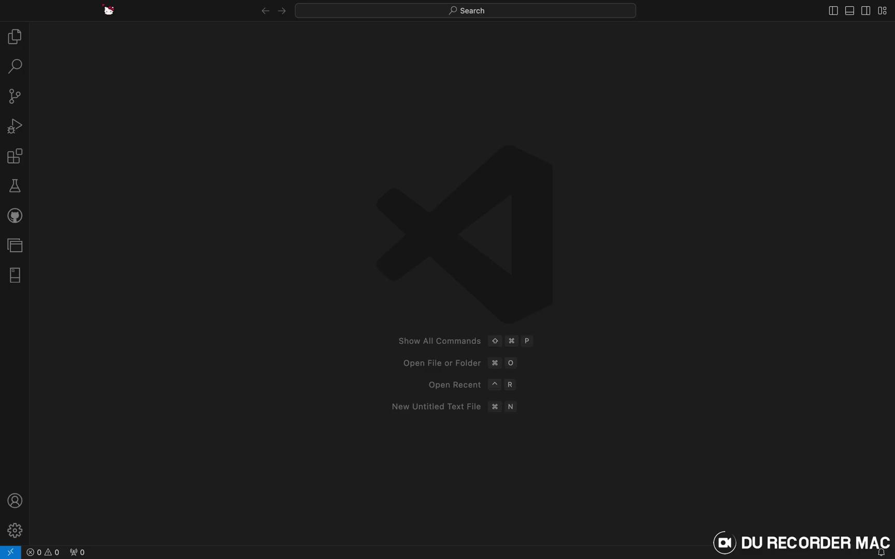
Creating new file

Slide 7
How to github
1. Fork the Repository on GitHub:
Click on the GitHub link shared, which will open the repository in web browser.
Click the "Fork" button at the top right corner of the repository page.
This will create a personal copy of the repository under your GitHub account.
2. Clone the Forked Repository to VSCode:
Open VSCode:
Open the Command Palette:
Press Ctrl + Shift + P (or Cmd + Shift + P on Mac) to open the Command Palette.
Clone the Repository:
Type Git: Clone and select it.
Paste the URL of your forked repository from your GitHub account and choose a local folder where you want to save the repository.
Open the Repository:
Once the repository is cloned, VSCode will prompt to open the repository. Click "Open" to open the project in VSCode.

Slide 8
How to github
3. Explore and Work on the Materials:
you can now browse through the folders and files in the repository from the VSCode sidebar.
4. Open Files and Edit:
They can open any .py or .ipynb files and start working on the exercises, making changes in your local copy.
5. Run the Code:
To run Python scripts, you can right-click the file and choose “Run Python File in Terminal” or use the run button at the top right corner.
For Jupyter notebooks (.ipynb files), you can run the cells directly in VSCode if the Jupyter extension is installed.
6. Commit Changes Locally:
Make Changes: you can make changes to the files as you work through the exercises.
Stage and Commit Changes: In the Source Control tab, you can stage your changes (click on the +icon next to each file) and commit with a message (e.g., “Completed exercise 1”).

Slide 9
How to github
7. Push Changes to Their Forked Repository:
Push to GitHub:
After committing changes, you can push the changes to your forked repository on GitHub by clicking the "Sync Changes" button in the Source Control tab.
This allows you to save your progress online without affecting the original repository.

Slide 10
setting up branches
1. Set Up Git in Your Project (if not already done)
Initialize Git: If your project is not already a Git repository, initialize it by opening the terminal in VSCode (Ctrl + or Cmd + on Mac) and running: Copy code: git init
Check Git Status: Run the following command to ensure that Git is tracking your files: bash Copy code: git status
2. Creating a New Branch in VSCode
You can create a branch directly from the VSCode interface or using the terminal.
In the Source Control panel (shortcut: Ctrl + Shift + G or Cmd + Shift + G), you’ll see your current branch name at the bottom of the screen.
Click on the branch name in the bottom-left corner of VSCode.
Select Create New Branch.
Give your branch a name, e.g., feature-branch, and press Enter.

Slide 11
Switching Between Branches
Method 1: Using VSCode UI
Click on the current branch name in the bottom-left corner.
Select the branch you want to switch to from the list of available branches.
Method 2: Using the Terminal
To switch to an existing branch, use the command: bash git checkout branch-name

Slide 12
Merging Branches
Switch to the branch you want to merge into. For example, to merge a feature branch into the main branch: bash Copy code : git checkout main
Merge the feature branch: bash Copy code: git merge feature-branch
Resolve any conflicts if they arise, and then commit the merge: bash Copy code: git commit -m "Merged feature-branch into main"

Slide 13
Deleting a Branch After Merging
Mthd 1: Using VSCode UI
In the bottom-left corner, click the branch name.
Select Delete Branch for the branch you want to remove.
Mthd 2: Using the Terminal
Run the following command to delete a branch locally: bash Copy code: git branch -d feature-branch

Slide 14
setting up requirements.txt
What is a requirements.txt
Lists Dependencies: It includes the names of the Python packages and often their specific versions, which are needed for the project.
Version Management: You can specify exact versions of the libraries to ensure consistency across different environments.
Installation: You can install all the listed packages in one go using pip:
Copy code: pip install -r requirements.txt

Slide 15
setting up requirements.txt
Installing from requirements.txt:
If you have a project with a requirements.txt file, you can install all the required packages using:
Copy code: pip install -r requirements.txt

